Slide 1
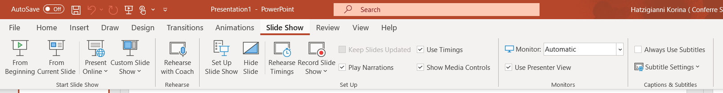
Recorded Presentation Instructions
Please send your pre recorded presentation at abstracts@shipsancongress2024.eu
no later than ​11/​1​0/2024
Please open the PowerPoint file of your oral presentation. Go to the “Slide Show” and select “Record Slide Show”, as shown below:
In some versions of PowerPoint (usually the older ones) the recording of your voice starts immediately with your first slide.
In other versions of PowerPoint (usually the newer ones), the pop-up window that you see in the following slide appears with all available tools regarding the recording.
Notes:
Let’s do a quick review of the technical requirements you’ll need to do the webinar.
First of all, run the quick test available at https://smart.newrow.com/room/testPage/ (this link should be provided to the client along with the links after the webinar setup, so they can ask the faculty to run it ahead of time! This has now been added to the task templates)
You don’t need to download or install anything - all you will need is to make sure to use a compatible web browser. Google Chrome tends to work best but Microsoft Edge and Mozilla Firefox are also acceptable.
Mac and Apple users - PLEASE NOTE that Safari browser WILL NOT WORK. Please make sure to download a different web browser ahead of time.
You’ll also need a high-speed internet connection of at least 10 Mbps (preferably wired) so that audio and video streaming quality isn’t affected. Please go ahead and test your internet speed now and also on the day of the event to make sure there aren’t any issues.
In addition, close any other tabs or programs that you aren’t using as these can slow down your device.

Slide 2
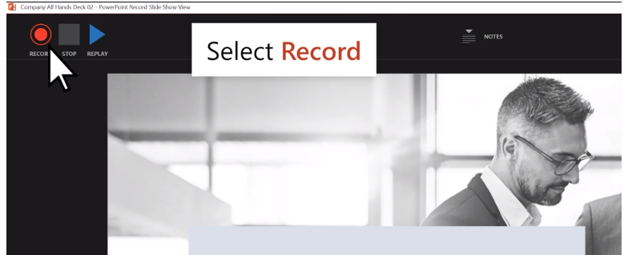
Press record and follow the instructions

Slide 3
Saving the file & recording
To save your ppt file presentation along with the recordings you have made in a video file, click “file” on the ribbon and go to “export” as shown in the next slide.

Slide 4
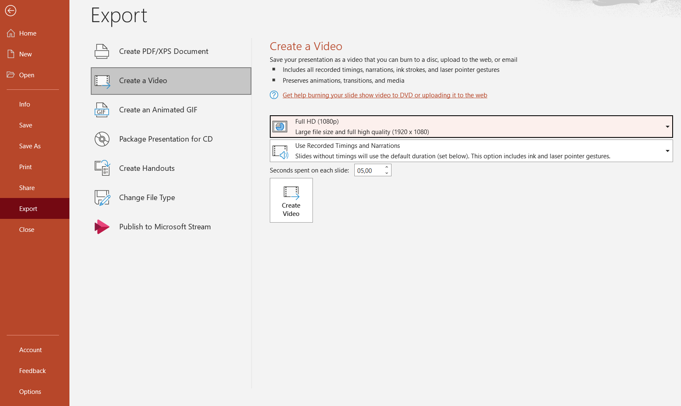
Select “Create a Video” as shown above and then select the video quality. We recommend Full HD (1080p). Finally, click “ Create Video “ and your presentation is exported. You will need to name the file and select a folder to save it in. The conversion may take some time, depending on the number/size of the slides.

Slide 5
The total duration must not exceed 5 minutes.
Please send your recorded presentation at abstracts@shipsancongress2024.eu no later than ​11/​1​0/2024 to be presented according to the scientific program. Any recorded presentations sent overdue will not be accepted.
If due to technical restrictions you cannot email over-sized files, please try sending the file through the following free alternative route:
For any further assistance or information, please do not hesitate to contact us at apolitopoulou@congressworld.gr
http://www.Wetransfer.com

